Slide 1
Java Enterprise Edition
Giorno 3

Slide 2
Giorno 3
I pattern GoF e i pattern Java EE.
Accesso agli oggetti: dependency injection con CDI o JNDI lookup.
Accesso ai dati attraverso framework di mapping: JDBC vs. SQL mapper vs. Object Relational Mapping.
Accedere ai dati con JPA:
ORM (object/relational mapping), le classi entità e l'entity manager,
campi e proprietà persistenti nelle classi entità,
gestione delle entità, unità di persistenza.

Slide 3
Design Patterns
Sono best practices per la realizzazione dei princìpi esposti in precedenza
Non c’è una definizione univoca per alcuni pattern e c’è sovrapposizione tra pattern architetturali e design patterns
I DP classici sono quelli di [GoF] e sono 23; sono stati estesi da [McConnell], [Fowler] e altri
Ai fini della nostra trattazione li dividiamo in due grandi categorie, eventualmente ulteriormente suddivise in sottocategorie
Design Patterns
Pattern creazionali
Pattern Strutturali
Pattern Comportamentali
Architectural Patterns
La seconda categoria verrà probabilmente ripresa in seguito insieme agli Enterprise Integration Patterns (EIP)

Slide 4
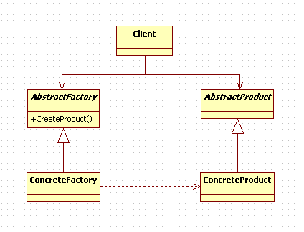
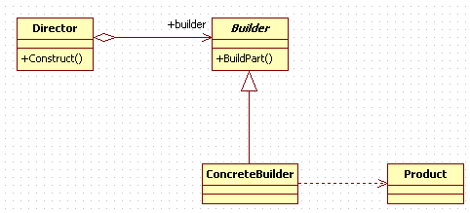
Pattern Creazionali (1)
Abstract Factory [GoF]
Provide an interface for creating families of related or dependent objects without specifying their concrete classes.
A hierarchy that encapsulates: many possible “platforms”, and the construction of a suite of “products”.
The new operator considered harmful.
Builder [GoF]
Separate the construction of a complex object from its representation so that the same construction process can create different representations.
Parse a complex representation, create one of several targets.

Slide 5
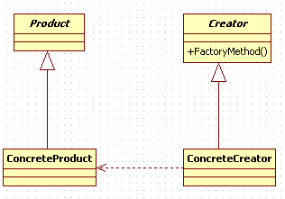
Pattern Creazionali (2)
Factory Method [GoF]
Define an interface for creating an object, but let subclasses decide which class to instantiate. Factory Method lets a class defer instantiation to subclasses.
Defining a “virtual” constructor.
The new operator considered harmful.
Lazy Initialization [Fowler]
Esiste già il pattern sviluppato in .NET 4.0 (Classe Lazy<T>)
Ritarda la creazione di un membro fino al primo utilizzo effettivo usando un flag
Multiton
Simile a Singleton, ma con molteplicità > 1
Usa un HashMap interna

Slide 6

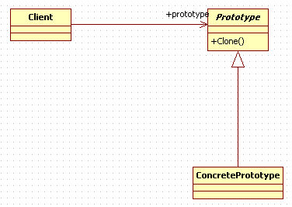
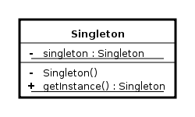
Pattern Creazionali (3)
Object Pool
Object pooling can offer a significant performance boost; it is most effective in situations where the cost of initializing a class instance is high, the rate of instantiation of a class is high, and the number of instantiations in use at any one time is low.
Prototype [GoF]
Specify the kinds of objects to create using a prototypical instance, and create new objects by copying this prototype.
Co-opt one instance of a class for use as a breeder of all future instances.
The new operator considered harmful.
Singleton [GoF]
Ensure a class has only one instance, and provide a global point of access to it.
Encapsulated “just-in-time initialization” or “initialization on first use”.

Slide 7
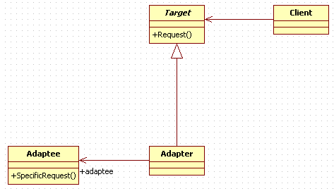
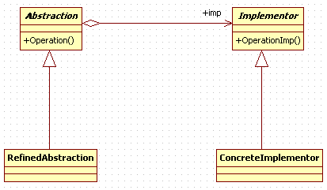
Pattern Strutturali (1)
Adapter (Wrapper) [GoF]
Convert the interface of a class into another interface clients expect. Adapter lets classes work together that couldn’t otherwise because of incompatible interfaces.
Wrap an existing class with a new interface.
Impedance match an old component to a new system
Bridge [GoF]
Decouple an abstraction from its implementation so that the two can vary independently.
Publish interface in an inheritance hierarchy, and bury implementation in its own inheritance hierarchy.
Beyond encapsulation, to insulation

Slide 8
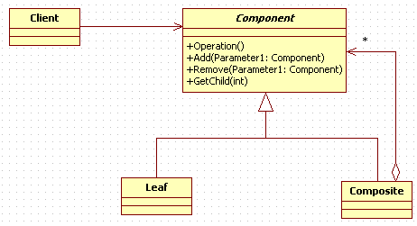
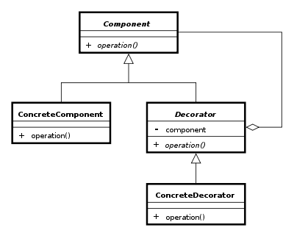
Pattern Strutturali (2)
Composite [GoF]
Composes objects into tree structures to represent part-whole hierarchies. Composite lets clients treat individual objects and compositions of objects uniformly.
Decorator
Attach additional responsibilities to an object dynamically. Decorators provide a flexible alternative to subclassing for extending functionality.
Client-specified embellishment of a core object by recursively wrapping it.
Wrapping a gift, putting it in a box, and wrapping the box.

Slide 9
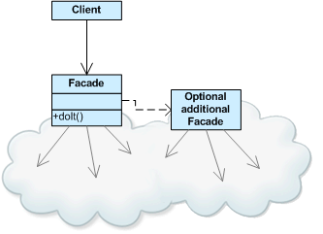
Pattern Strutturali (3)
Façade [GoF]
Provide a unified interface to a set of interfaces in a subsystem. Facade defines a higher-level interface that makes the subsystem easier to use.
Wrap a complicated subsystem with a simpler interface.
Front Controller [McCollen]
The Front Controller Pattern is a software design pattern listed in several pattern catalogs. The pattern relates to the design of web applications. It "provides a centralized entry point for handling requests.“

Slide 10
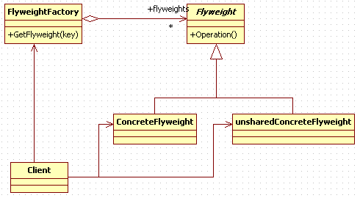
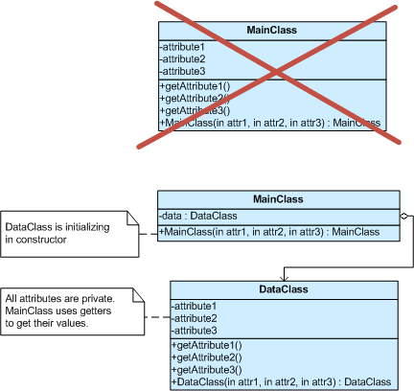
Pattern Strutturali (4)
Flyweight [GoF]
Use sharing to support large numbers of fine-grained objects efficiently.
The Motif GUI strategy of replacing heavy-weight widgets with light-weight gadgets.
Private Class Data
Control write access to class attributes
Separate data from methods that use it
Encapsulate class data initialization
Providing new type of final - final after constructor

Slide 11
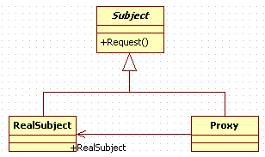
Pattern Strutturali (5)
Proxy [GoF]
Provide a surrogate or placeholder for another object to control access to it.
Use an extra level of indirection to support distributed, controlled, or intelligent access.
Add a wrapper and delegation to protect the real component from undue complexity.

Slide 12
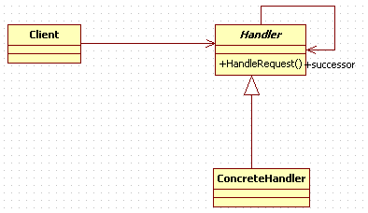
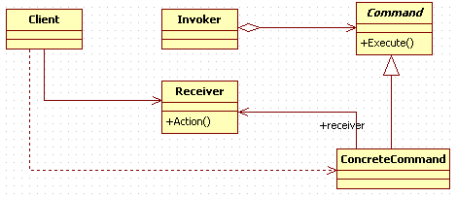
Pattern Comportamentali (1)
Chain of Responsibility [GoF]
Avoid coupling the sender of a request to its receiver by giving more than one object a chance to handle the request. Chain the receiving objects and pass the request along the chain until an object handles it.
Launch-and-leave requests with a single processing pipeline that contains many possible handlers.
An object-oriented linked list with recursive traversal.
Command [GoF]
Encapsulate a request as an object, thereby letting you parameterize clients with different requests, queue or log requests, and support undoable operations.
Promote “invocation of a method on an object” to full object status
An object-oriented callback

Slide 13
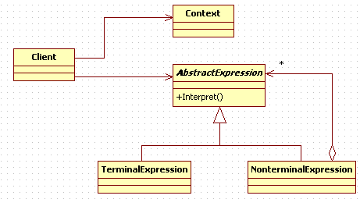
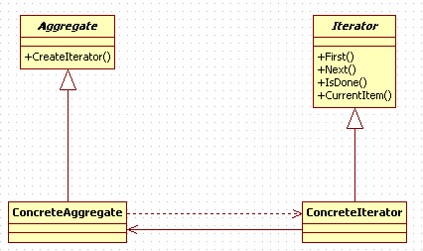
Pattern Comportamentali (2)
Interpreter
Given a language, define a representation for its grammar along with an interpreter that uses the representation to interpret sentences in the language.
Map a domain to a language, the language to a grammar, and the grammar to a hierarchical object-oriented design.
Iterator
Provide a way to access the elements of an aggregate object sequentially without exposing its underlying representation.
The C++ and Java standard library abstraction that makes it possible to decouple collection classes and algorithms.
Promote to “full object status” the traversal of a collection.
Polymorphic traversal

Slide 14
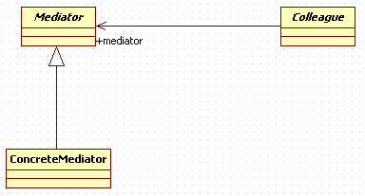

Pattern Comportamentali (3)
Mediator
Define an object that encapsulates how a set of objects interact. Mediator promotes loose coupling by keeping objects from referring to each other explicitly, and it lets you vary their interaction independently.
Design an intermediary to decouple many peers.
Promote the many-to-many relationships between interacting peers to “full object status”.
Memento
Without violating encapsulation, capture and externalize an object’s internal state so that the object can be returned to this state later.
A magic cookie that encapsulates a “check point” capability.
Promote undo or rollback to full object status.

Slide 15
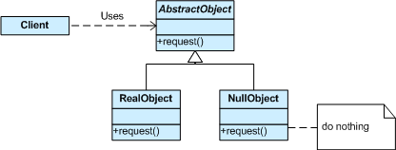
Pattern Comportamentali (4)
Null Object
The intent of a Null Object is to encapsulate the absence of an object by providing a substitutable alternative that offers suitable default do nothing behavior. In short, a design where “nothing will come of nothing”. Use when:
an object requires a collaborator. The Null Object pattern does not introduce this collaboration—it makes use of a collaboration that already exists
some collaborator instances should do nothing
you want to abstract the handling of null away from the client

Slide 16
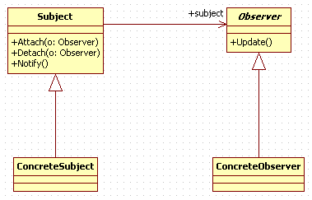
Pattern Comportamentali (5)
Observer (Publish/Subscribe) & Blackboard
Define a one-to-many dependency between objects so that when one object changes state, all its dependents are notified and updated automatically.
Encapsulate the core (or common or engine) components in a Subject abstraction, and the variable (or optional or user interface) components in an Observer hierarchy.
The “View” part of Model-View-Controller.
Blackboard: Generalized observer, which allows multiple readers and writers. Communicates information system-wide.

Slide 17
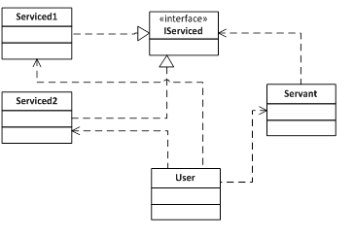
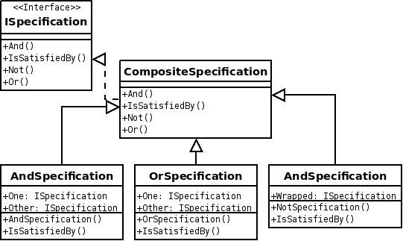
Pattern Comportamentali (6)
Servant
Servant is a design pattern used to offer some functionality to a group of classes without defining that functionality in each of them. A Servant is a class whose instance (or even just class) provides methods that take care of a desired service, while objects for which (or with whom) the servant does something, takes as parameters.
Specification
A specification pattern outlines a unit of business logic that is combinable with other business logic units. In this pattern, a unit of business logic inherits its functionality from the abstract aggregate Composite Specification class. The Composite Specification class has one function called IsSatisfiedBy that returns a boolean value. After instantiation, the specification is "chained" with other specifications, making new specifications easily maintainable, yet highly customizable business logic. Furthermore upon instantiation the business logic may, through method invocation or inversion of control, have its state altered in order to become a delegate of other classes such as a persistence repository.

Slide 18
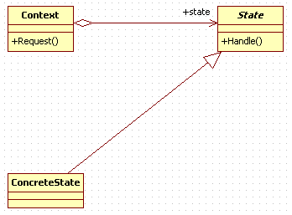
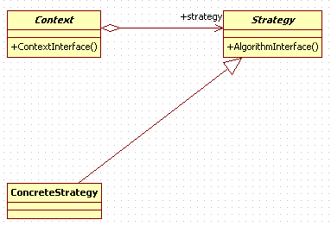
Pattern Comportamentali (7)
State
Allow an object to alter its behavior when its internal state changes. The object will appear to change its class.
An object-oriented state machine
wrapper + polymorphic wrappee + collaboration
Strategy
Define a family of algorithms, encapsulate each one, and make them interchangeable. Strategy lets the algorithm vary independently from the clients that use it.
Capture the abstraction in an interface, bury implementation details in derived classes.

Slide 19
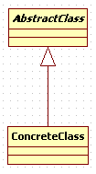
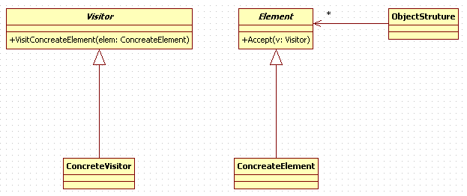
Pattern Comportamentali (8)
Template Method
Define the skeleton of an algorithm in an operation, deferring some steps to client subclasses. Template Method lets subclasses redefine certain steps of an algorithm without changing the algorithm’s structure.
Base class declares algorithm ‘placeholders’, and derived classes implement the placeholders.
Visitor
Represent an operation to be performed on the elements of an object structure. Visitor lets you define a new operation without changing the classes of the elements on which it operates.
The classic technique for recovering lost type information.
Do the right thing based on the type of two objects.
Double dispatch

